Slide 1
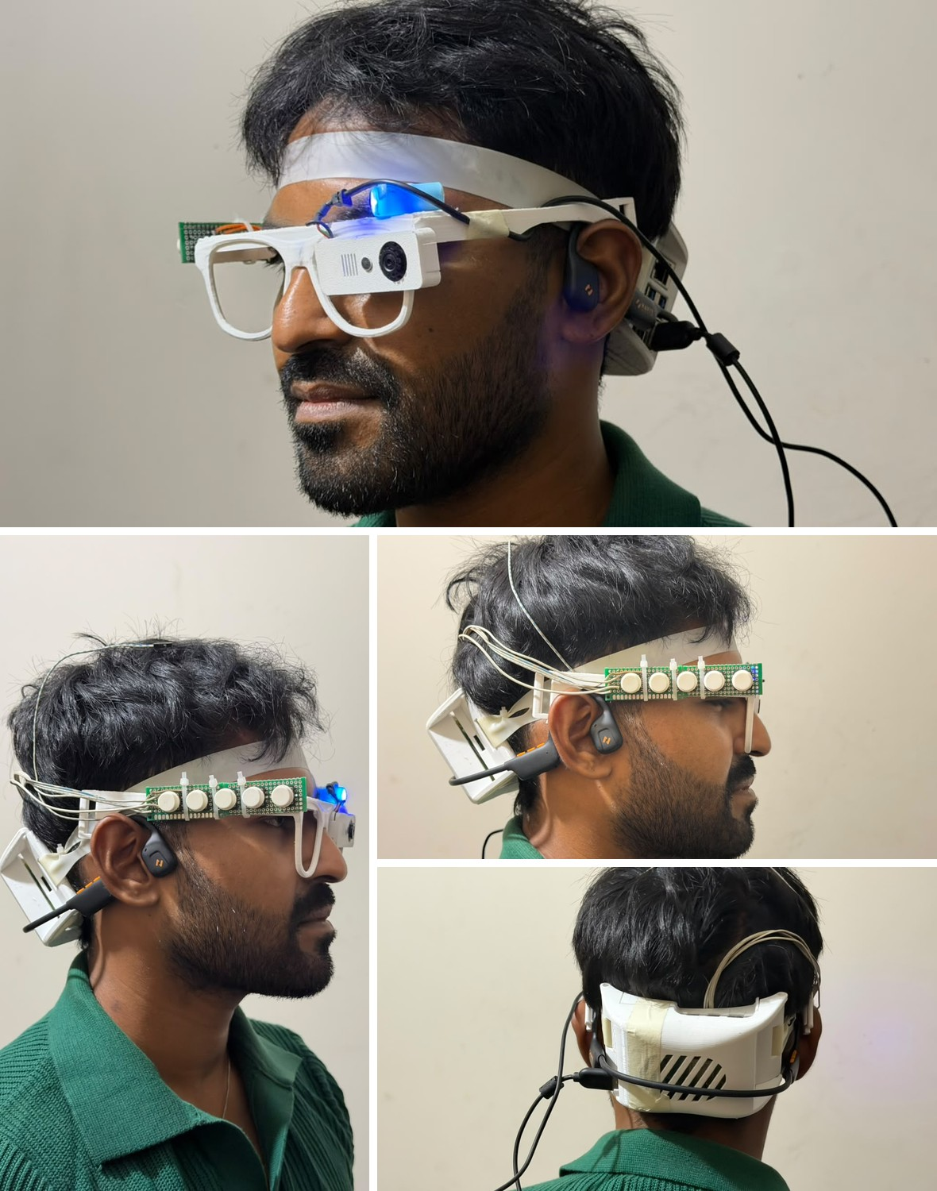

SARA · Smart Assistive Reading Aid
A Wearable Assistive Robot for Authenticating Bangladeshi Banknotes: Fusing Physical Security Features and Deep Learning for Visually Impaired Users
MD Abdun Fattah Lam (2220014) · Mukut Protim Memo (2020086)
Tanjila Hossain Tapti (2130561)
Supervisor: Mohammad Shidujaman, PhD, Assistant Professor
Department of Computer Science and Engineering, Independent University, Bangladesh
Notes:
We present SARA, a smart glass for blind and low-vision people in Bangladesh. It reads Bangla and English text, names objects, recognises Taka notes and checks them carefully, and it works on the device without the internet. The photo is the current prototype.

Slide 2
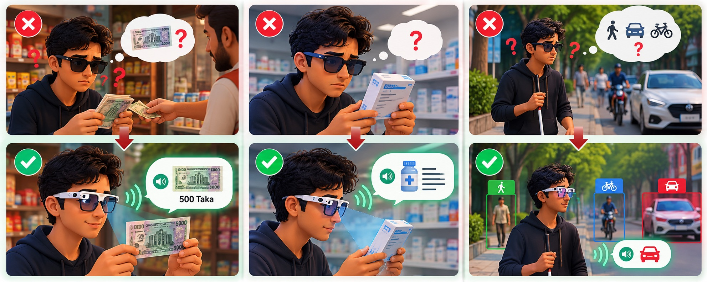
Three everyday challenges
Money
Reading
Surroundings
Illustration
Notes:
Three everyday moments; the top row is today, the bottom row is with SARA. At the shop, the blind customer receives change and must trust the shopkeeper about which note it is and whether it is real. At the pharmacy, the medicine label is in Bangla and no affordable device reads it. On the street, they must stop and ask a stranger what is ahead. In every case the answer comes from another person and cannot be checked. With SARA, the glass names the note, reads the label and names what is ahead.

Slide 3



Why existing solutions fall short
Limited Bangla support
2.2 billion
OrCam MyEye does not support Bangla [2]
people worldwide have a near or distance vision impairment [1]
Internet dependence
Research glasses send pictures to a server [3, 4]
most of them in low- and middle-income regions [1]
Limited Taka verification
Reviewed systems do not name Taka notes [2, 3, 4]
Sources: [1] WHO 2023; [2] OrCam MyEye; [3] Ali A. et al., IEEE Access 2021; [4] Brilli et al., arXiv 2024.
Notes:
The World Health Organization counts at least 2.2 billion people with a vision impairment, most of them in low- and middle-income countries. Three gaps keep existing help away from Bangladeshi users. OrCam MyEye, the best-known commercial reading glass, does not support Bangla. The research glasses we reviewed send every picture to a cloud server, so without a network there is no answer. And none of the systems we reviewed names Bangladeshi Taka notes, let alone screens them safely: a wrong value or a false accusation of counterfeit has real costs.

Slide 4
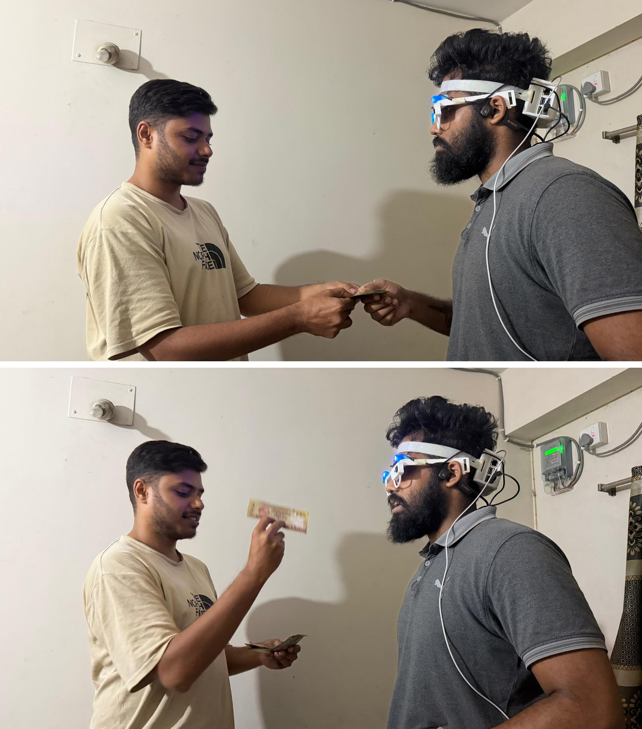






SARA in action: ask the glass, not a stranger
Speak
Detect offline
Hear the answer
"Glass, check money"
Raspberry Pi 5, no internet
Bangla speech + vibration
Money
Reading
Surroundings
Names the note and screens it with care
Reads Bangla and English labels aloud
Names people and objects ahead
Our prototype in a staged shop exchange: receiving a note, holding it up to the camera
পাঁচশত টাকার নোট "500 Taka note": the answer the glass speaks
Offline: text, objects, Taka, emotion. Optional online: scene description only.
Notes:
Here is the same moment with SARA. The user says glass, check money. The camera picture is processed on the Raspberry Pi 5 without the internet, and the glass answers in Bangla, for example five hundred Taka note, with a short vibration. The same three steps read a medicine label or name what is ahead.

Slide 5
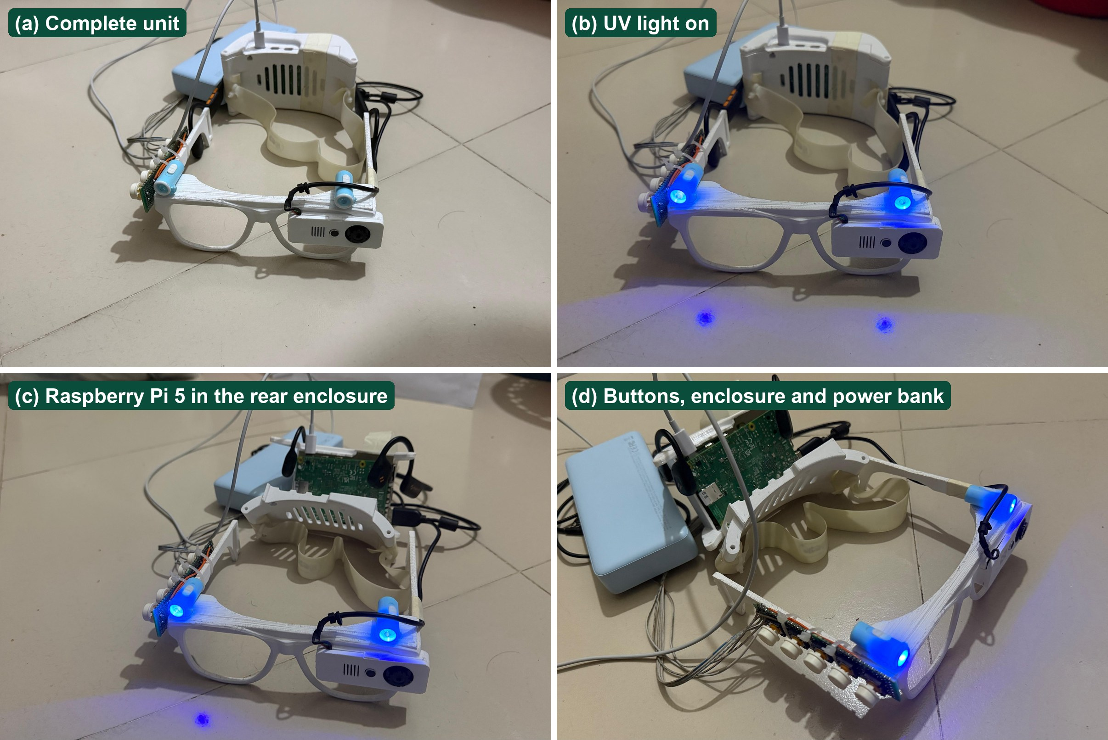




Five modes, started by button or by voice
Text reading
Objects
Taka notes
Bangla and English
Named in Bangla
Value + safe check
Emotion
Online description
Face in front
Optional; needs internet
Prototype version 2: the complete unit, the UV light on, the Pi 5 in the rear enclosure, buttons and power bank
How the user starts a mode: five buttons on the frame, or a voice command: "Glass, read text"
Notes:
This is the current prototype: the camera and five buttons sit on the frame, a bone-conduction earphone leaves the ears free, and the Raspberry Pi 5 rides in a ventilated enclosure at the back of the head. Five modes cover text, objects, Taka notes, emotion and an optional online description. Every mode can be started with a button or with a voice command that begins with the word glass.

Slide 6
Six research questions
1
System
2
Synthetic data
3
Number of views
Can it all run on a Raspberry Pi 5?
Can unlabelled training data detect real notes?
Can one view of a note be enough?
4
Unseen prints
5
Safety
6
Bangla OCR
Does the check hold on new counterfeit prints?
Can it never accuse a genuine note?
What matters most for reading Bangla?
Notes:
Six questions organise the talk. First, whether a multi-function Bangla glass runs on a Raspberry Pi 5 and how fast. Second, whether a Taka detector trained without hand labels works on real, hand-held photos. Third, why multi-view counterfeit models fail with fewer views and whether training fixes it. Fourth, how much accuracy drops on counterfeit prints never seen in training. Fifth, whether the glass can give counterfeit advice that never accuses a genuine note. Sixth, which part of a Bangla OCR pipeline matters most for a wearable camera.

Slide 7
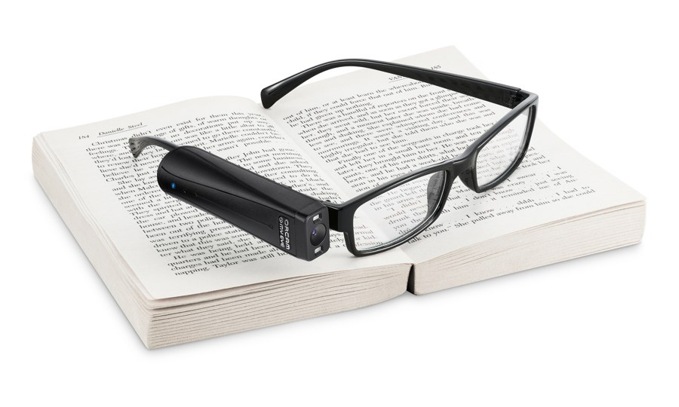
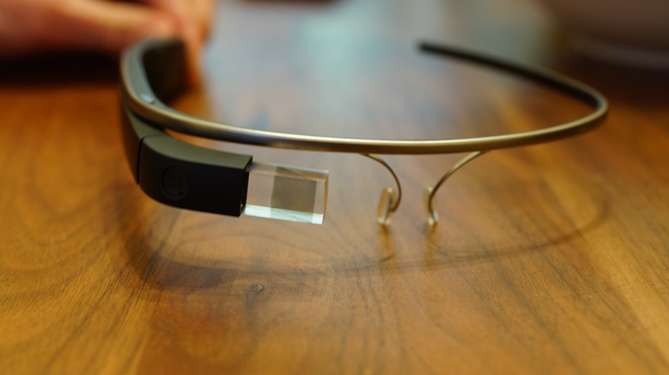
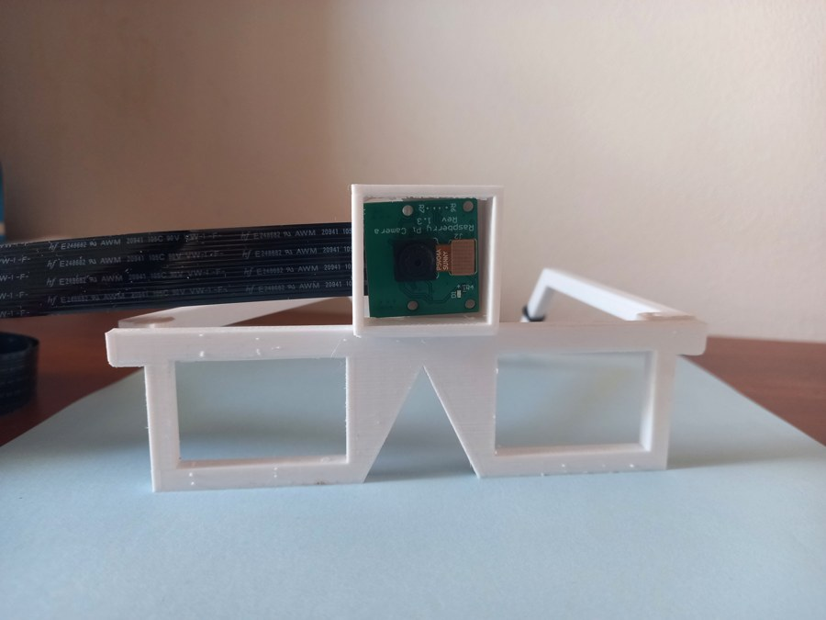
What existing devices miss
System | Reads Bangla | Knows Taka | Works offline | Wearable
OrCam MyEye [2] | No | No | Yes | Yes
Google Glass scene analysis [3] | No | No | No | Yes
AIris (2024) [4] | No | No | No | Yes
Raspberry Pi reading aids * | No | No | Partly | Partly
SARA (ours) | Yes | Yes | Yes | Yes
The research gap
None of the systems we reviewed combines Bangla, Taka and offline use.
Counterfeit tests reuse the same prints
Few report speed on the real device
Rows with a reference: from the cited source. * Our assessment of typical hobby builds, not a cited result.
OrCam MyEye [2]
Google Glass analysis [3]
AIris [4]
Photos: OrCam MyEye by Ylip, CC BY-SA 4.0; Google Glass by Ted Eytan, CC BY-SA 2.0 (Wikimedia Commons); AIris from [4]. Comparison from [2, 3, 4].
Notes:
Commercial glasses such as OrCam work offline but not in Bangla and not with Taka. Glass-based research systems send pictures to a server. Raspberry Pi reading aids are cheap but mostly English. No device combines Bangla, Taka and offline use, and counterfeit studies do not check for copies of the same print in training and test.

Slide 8

How the glass works
Camera, buttons, voice
Raspberry Pi 5
AI modules
Audio + vibration
Camera 640×480
5 buttons on the frame
Voice: "glass, …"
Mode manager
All models on the CPU
Offline, except the online mode
Text: CRAFT + EasyOCR [5, 6]
Objects: YOLOv8s, COCO [7, 8]
Taka: YOLOv8s + safe checks
Emotion: YuNet + EfficientNet [9]
Online: cloud model (optional)
Bangla or English speech [10, 11]
Vibration for a note
Everything runs on the glass itself; only the optional online mode uses the internet.
Sources: [5] Baek et al. 2019; [6] EasyOCR; [7] Ultralytics YOLOv8; [8] COCO; [9] RAF-DB; [10] Piper; [11] eSpeak NG.
Notes:
The camera picture, the buttons and voice commands go to a mode manager on the Raspberry Pi 5. The active mode runs its model on the CPU, and the result is spoken in Bangla or English, with a vibration for a detected note.

Slide 9
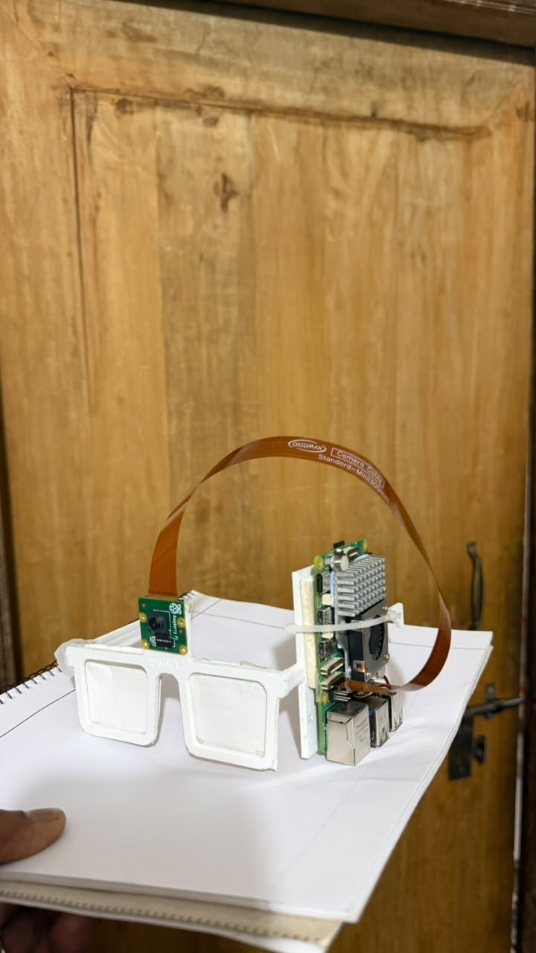
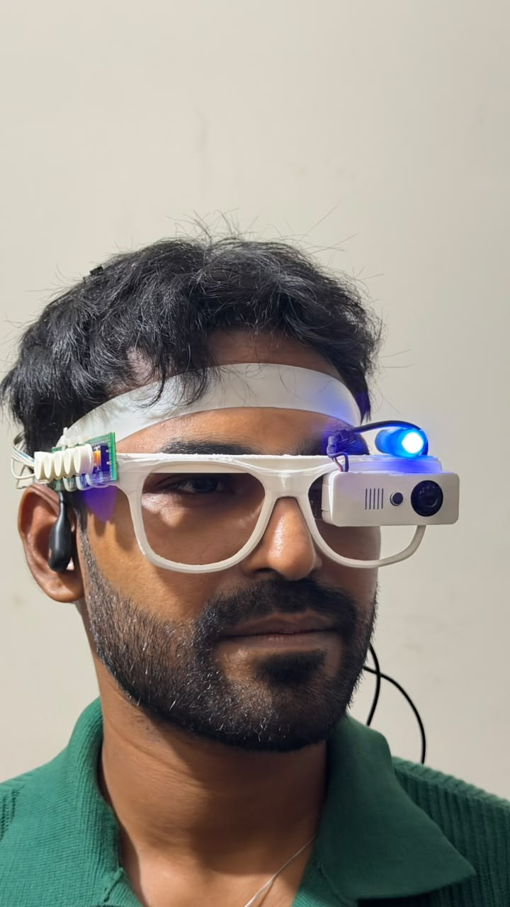
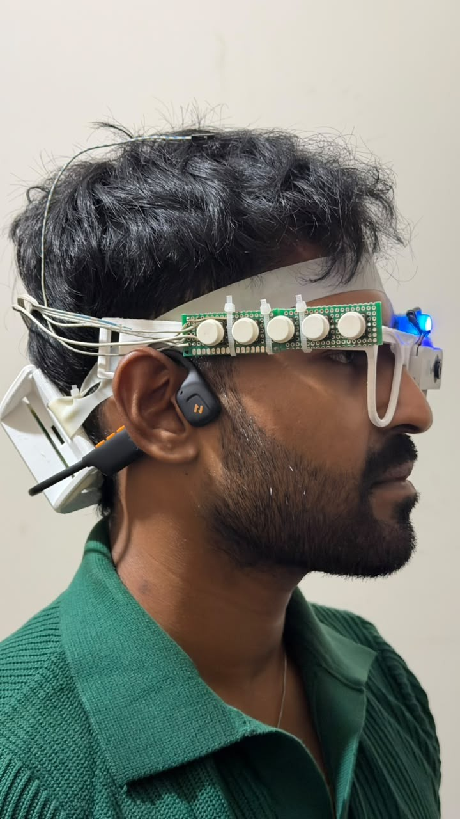
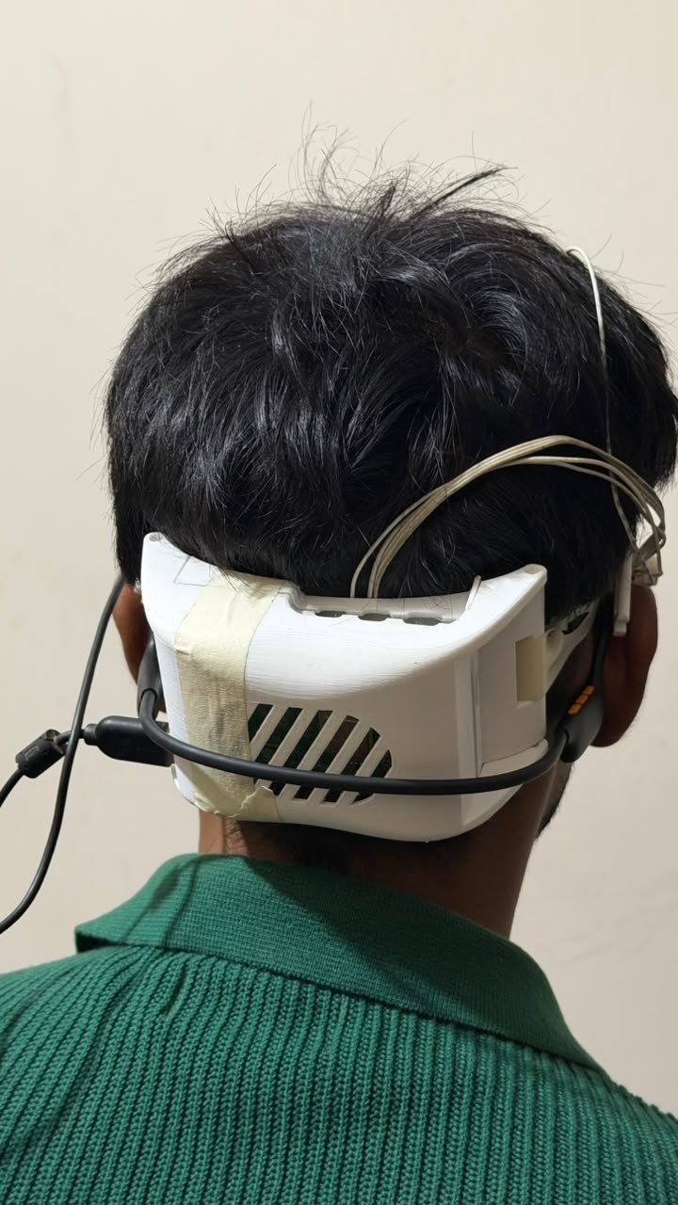
From a desk prototype to a wearable glass
Version 2
Version 1
Board on one temple
Front
Camera + UV lamp
Side
5 buttons, bone-conduction earphone
Rear
Pi 5 in a ventilated case
Notes:
The first version put the board and fan on one temple: heavy on one side and loud by the ear. Version two moves the Raspberry Pi into a ventilated enclosure at the back of the head, keeps the camera and a small UV lamp on the front, puts five buttons along the frame and uses a bone-conduction earphone so the ears stay free for traffic sounds.

Slide 10
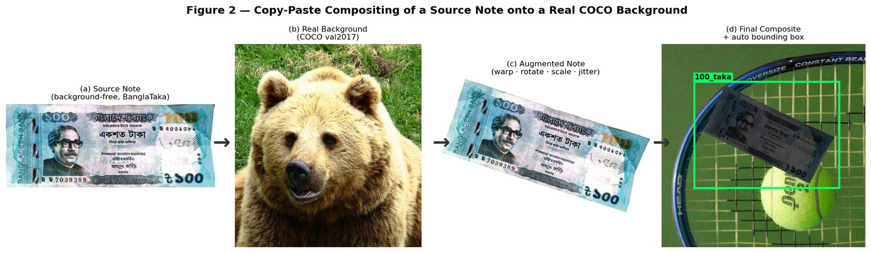
Taka detection: 22,333 training images, no hand labels
SYNTHETIC COMPOSITES
0.995
mAP@0.5 on 2,282 held-out composites
Note photos [12] are pasted onto real scenes [8], and the program writes every label itself.
REAL PHOTOS
94.1%
right note value on 1,536 photos taken by other people (laptop)
Sources: [12] BanglaTaka (Mendeley); [8] Lin et al., COCO, ECCV 2014; detector [7] Ultralytics YOLOv8. 94.1% with the hand-held detector (next slide).
Notes:
Public Taka images are clean close-ups, so a model trained on them fails on a live camera. We pasted 5,073 note photos onto real COCO pictures with random angle, scale, light and blur, and let the program write the box labels. The detector scores 0.995 mAP on held-out composites and, the number that matters for users, names 94.1 percent of 1,536 real photographs taken by other people correctly. The two numbers measure different things: the first is on synthetic composites, the second on real photos.

Slide 11
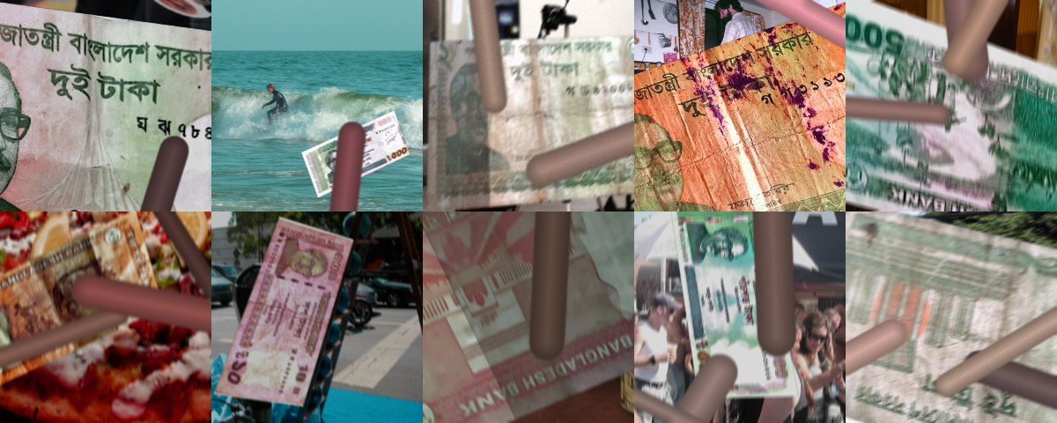
Notes held in a hand: from 1 in 8 to 1 in 2
TRAINING: 6,000 SYNTHETIC CLOSE-UPS
TEST: REAL HAND-HELD PHOTOS
11.8% → 47.5%
Right note value on the laptop. Trade-off: with 3 notes in view, the total is right 97.0% (was 99.2%).
Sources: test photos [13] Rafi et al., NSTU-BDTAKA, Data in Brief 2024; detector [7] YOLOv8. Our results: paper_evidence/HANDHELD_FINETUNE.md.
Notes:
A blind user holds the note close, folded and under the fingers, and our training pictures showed whole notes in scenes. We generated six thousand hand-held close-ups from training notes only and fine-tuned the detector. On the independent NSTU hand-held test, the right value rises from 11.8 to 47.5 percent on the laptop and from 8.7 to 33.5 percent on the Pi. There are costs: one-taka notes are named more often by mistake (36.6 percent), and with three notes in view the total is right 97.0 percent of the time instead of 99.2.

Slide 12
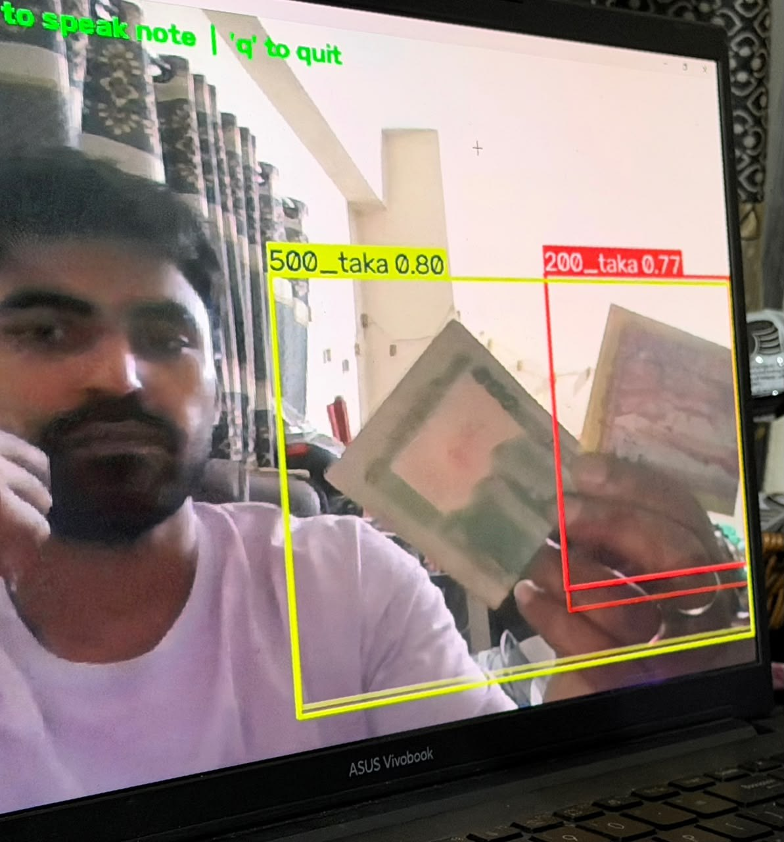
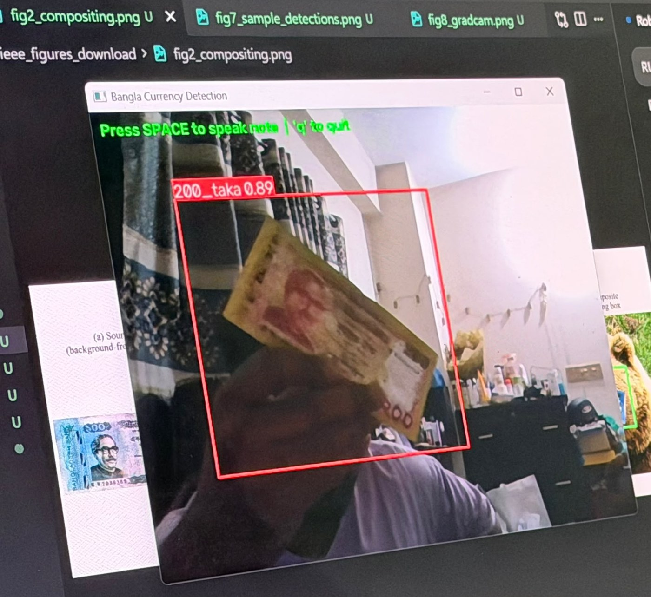
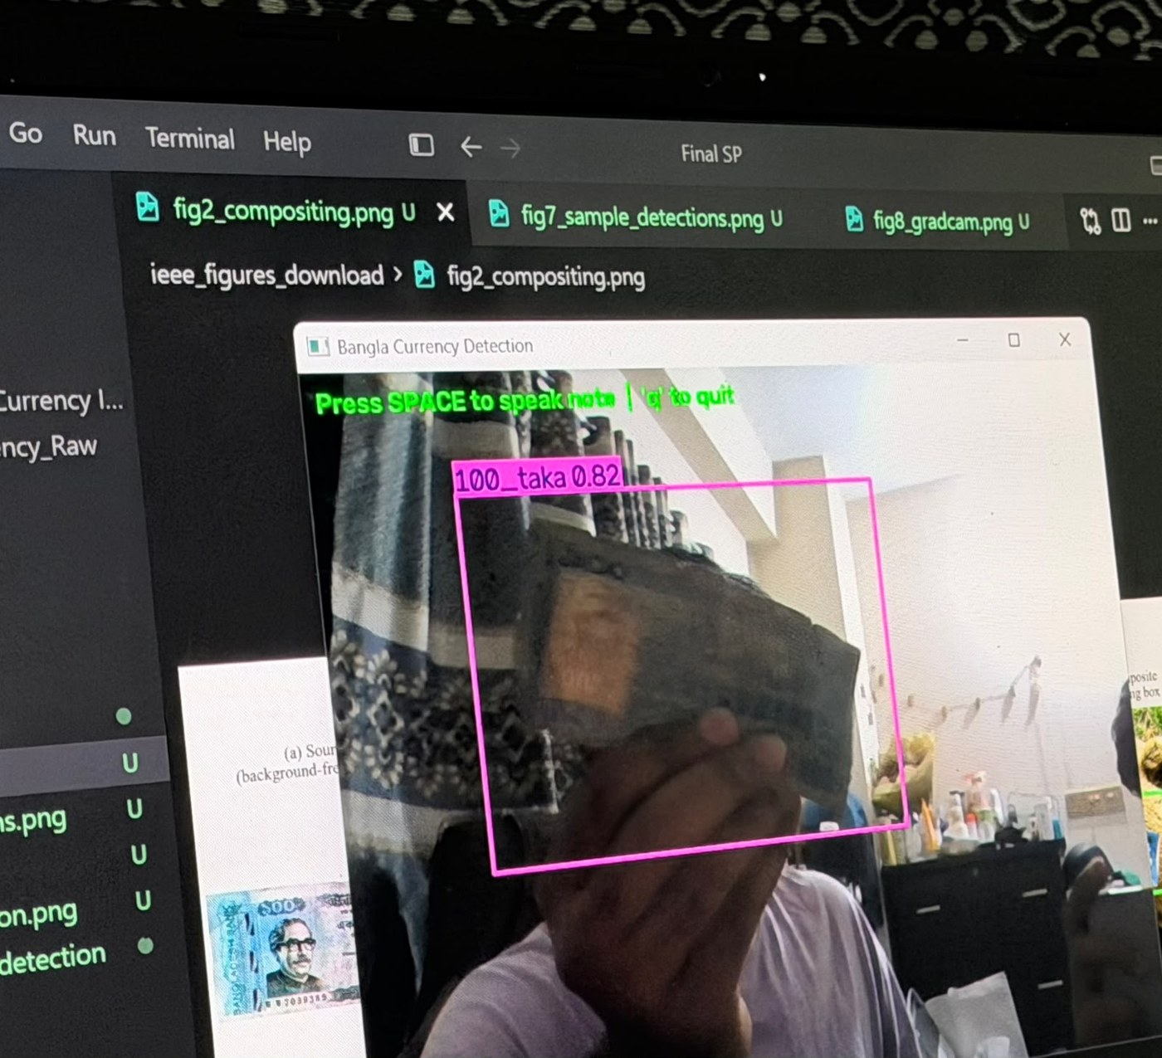
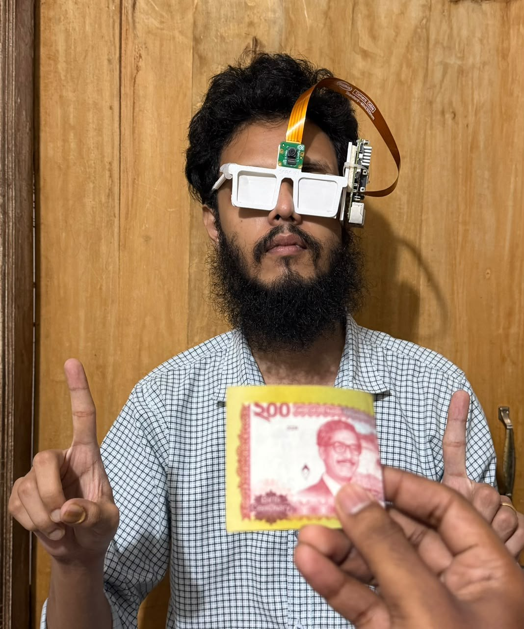
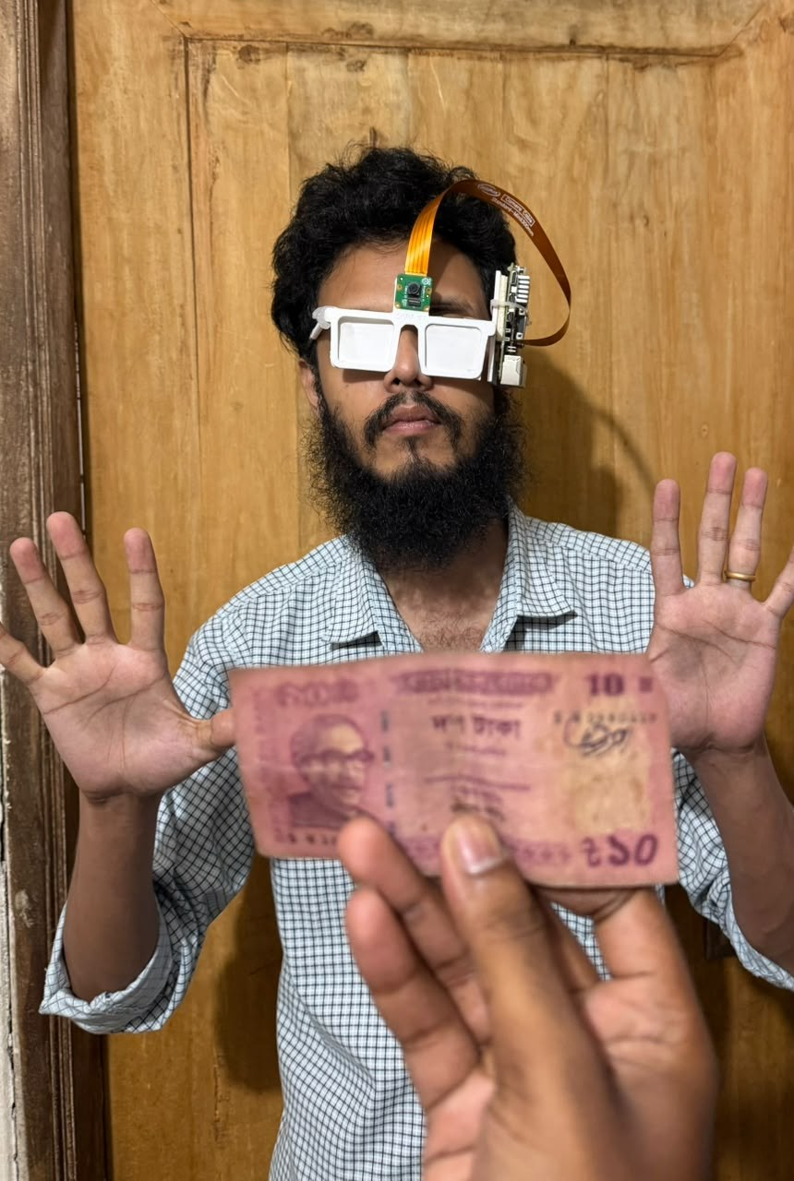
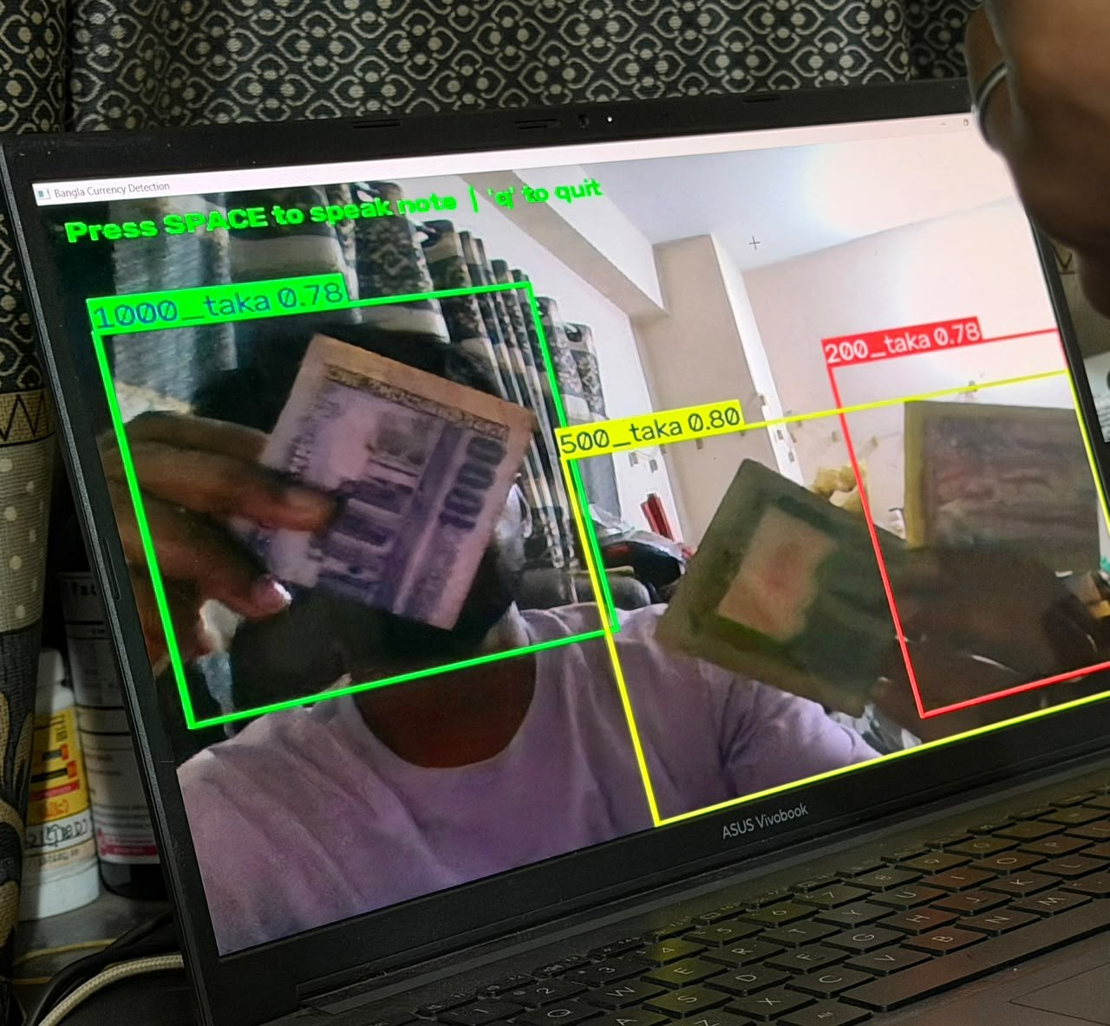
Live tests with real notes
Informal demonstrations, not a measured accuracy study
Six note values (10 to 1,000 Taka) named at 0.63–0.89 confidence, including worn and folded notes. Laptop webcam and the first glass prototype.
Notes:
These are live sessions with our own notes, with a laptop webcam and the first glass prototype. Ten, fifty, one hundred, two hundred, five hundred and one thousand Taka were named at 0.63 to 0.89 confidence, including worn and folded notes and two or three notes at once. Boxes are loose and can overlap when notes are close. These photos illustrate behaviour; we did not count an error rate in these sessions.

Slide 13
Counterfeit check: one view is enough with prefix training
With a single view
71.2%
rises to
98.2%
Training on random first views: one view is enough.
Held-out JaalTaka test notes, never used for training or for any choice
Data: [14, 15] Piyas et al., JaalTaka dataset and article, 2025-2026 (1,390 notes, six views each; counterfeits seized by the Rapid Action Battalion).
Notes:
A blind user cannot promise to capture six views of a note. A model trained only with all six views collapses to 71 percent with one view. Training on random prefixes of the views, that is the first k views for a random k, keeps it at about 98 percent from one to six views, with no loss at six views and stable results across three seeds.

Slide 14
Unseen counterfeit prints: a stricter test
95.0%
on counterfeit prints never seen in training, with the watermark check
Why a stricter split: 279 of 322 readable 500 Taka counterfeits share one serial number, so the usual split tests copies of known prints.
Data: [14] JaalTaka; serial-number audit and print-disjoint split are ours. Earlier Taka counterfeit work: [16] SVM on security features; [17] CNNs; [19] UV flecks + RPN.
Notes:
Most counterfeit notes in JaalTaka are copies of a few prints, so the usual test measures recognition of known reprints; a serial-number lookup alone scores 90.2 percent. On truly unseen prints our network drops to about 89 percent; adding the watermark check brings it to 95 percent.

Slide 15
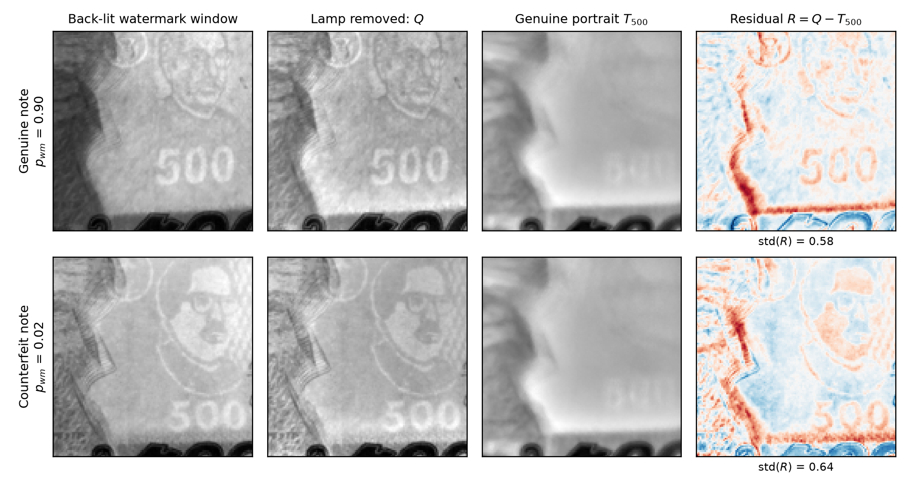
DMWR: a tiny, physics-based watermark checker
91.5%
on unseen counterfeit prints (3 seeds, ±0.3)
46× smaller
than MobileNetV2 [18] (47,818 parameters, 0.21 MB), and as accurate: 92.9%, p ≥ 0.375
1. Remove the lamp: Q = I / (G∗I)
2. Genuine portrait: T = median of Q over genuine notes
3. Residual R = Q − T → two small CNN streams → "watermark clear?"
Baseline [18] Sandler et al., MobileNetV2, CVPR 2018; data [14] JaalTaka. DMWR (denomination-matched watermark residual) is our method.
Notes:
Our watermark method divides the back-lit photo by a blurred copy to remove the lamp, subtracts a genuine portrait of the note value and classifies the residual with two tiny networks. With under fifty thousand parameters it reaches 91.5 percent on unseen prints, statistically level with a MobileNetV2 46 times larger.

Slide 16
Safe before decisive: the glass never says "counterfeit"
"Likely genuine"
0 / 88
Score above the safe threshold?
yes
test counterfeits passed as "likely genuine"
Note captured
no
"Check by hand" + guided watermark check
"Likely genuine": the score is higher than every counterfeit seen in validation (57.5% of genuine notes).
"Check by hand": the glass is not sure. It never means "counterfeit".
A screening aid, not a guaranteed counterfeit detector
Test notes: [14] JaalTaka.
Notes:
Because a blind user cannot verify the answer, the glass never says a note is counterfeit. It says likely genuine only above a threshold set from validation counterfeits; otherwise it asks for a check by hand. The threshold is the highest score of any validation counterfeit, so a new counterfeit passes with probability about 1 in n plus 1, roughly 1.1 percent. No test counterfeit passed, and 57.5 percent of genuine notes are confirmed from close-up views.

Slide 17
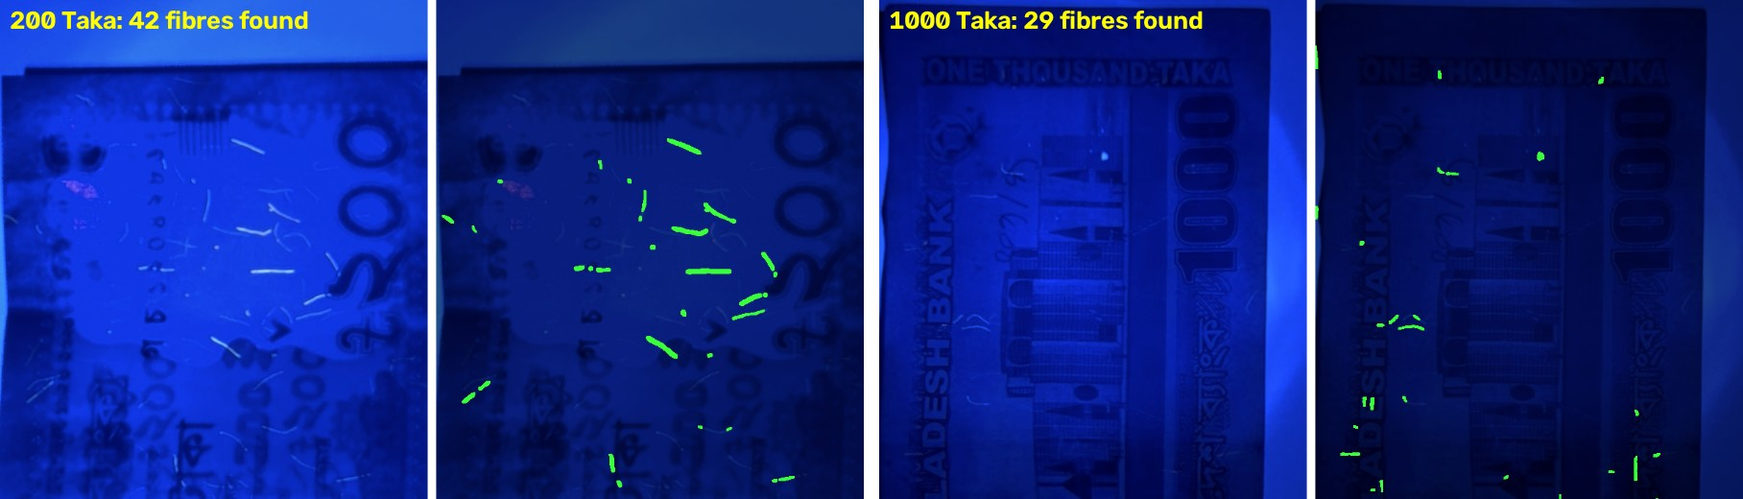
UV fibre check: the glass carries its own UV lamp
85.6%
88.6%
Prototype, off by default
The rejection result is simulated; it must be validated on real counterfeit notes
of 111 real UV photos of genuine notes accepted
of SIMULATED fibre-free sheets rejected (not real counterfeits)
The glass's lamp emits 360-395 nm, covering the 365 nm used for banknote checks; banknote paper stays dark while its fibres glow [20]. Prior Taka UV work: [19] (96.3%). Fibre check and photos are ours.
Notes:
Under a UV lamp, genuine 200, 500 and 1000 Taka notes show glowing security fibres. Our check removes the lamp's own blue light and counts thin glowing marks. It accepts 85.6 percent of real genuine photos and rejects 88.6 percent of simulated fibre-free sheets. It stays off by default until real counterfeits are tested.

Slide 18
Bangla reading: rendered text and real street photos
Rendered text (clean)
Real word photos (hard)
What helped
Reading the main text block only
Tuned detector and clean-up
Recogniser fine-tuned on real words
What did not
Binarisation, Tesseract, TrOCR, PaddleOCR, dictionaries
Character error rate, lower is better. Measured on evaluation datasets, not yet through the glass.
Engine [6] EasyOCR with [5] CRAFT; real words from [21] ICDAR 2019 MLT (1,000 test words). Every choice made on validation data.
Notes:
On our rendered Bangla and English benchmark the error fell from 9.3 to 2.3 percent. Real street words are much harder: a recogniser fine-tuned on real words and blended with the original weights lowered the error from 39.2 to 28.7 percent for Bangla and from 62.5 to 50.6 percent for Latin script. What helped: reading only the main block of text, tuned detector settings with CLAHE and clean-up rules, and the recogniser fine-tuned on real words and blended fifty-fifty with the original weights. Binarisation, multi-scale reading, Tesseract, TrOCR, PaddleOCR, dictionaries, smaller pictures and a rotation retry did not help.

Slide 19
Voice: a natural Bangla voice and spoken commands
212 → 13
Speaking
false commands in 5,040 ordinary sentences, thanks to the wake word
Natural Piper voice, Bangla and English [10, 11]
No broken sound when the Pi is busy
"পড়ছি" (reading) while text is captured
0.86 s
from the end of speech to the action (median)
Command results: synthetic voices on a laptop, not human trials on the glasses
Recogniser [22] Vosk; noise from [23] Piczak, ESC-50; voices [10, 11]. Results: paper_evidence/VOICE_COMMANDS_FAST.md.
Notes:
The glass now speaks with a natural Piper voice, with eSpeak NG as a fallback, and each sentence is rendered before it plays, which fixed the broken sound on the Pi; a short word and a soft tick tell the user that a long capture is running. These command results come from synthetic voices on a laptop, not from people wearing the glass. Commands start with the word glass. On twelve unseen synthetic voices, clean commands are always carried out, whispered ones 98.9 percent, with street noise as loud as the voice 82.5 percent, and with people talking nearby about half. The wake word cut false commands from 212 to 13.

Slide 20

Running on the Raspberry Pi 5
399 ms
64 ms
562 ms
Key finding: heat
currency check, end to end
watermark check
object scan (YOLOv8s)
88.7 °C
peak temperature; the Pi throttled in 76% of samples (idle 71 °C)
680 ms
18.3 s
1.48 GB
Response: a thermal governor slows background scans when hot; better cooling is future work.
emotion, face in view
3-line sign, text found once
peak memory, 30-minute run
Measured on a Raspberry Pi 5 (8 GB) on 13 October 2026, board at its temperature limit; memory from the 1 October run. Changes after 13 October are not yet timed on the Pi.
Notes:
Measured on the Raspberry Pi 5 itself. The currency check takes 0.4 seconds, the watermark check 64 milliseconds. Text reading is the slow part at about 18 seconds for a short sign. The board was hot in this run, so we added a thermal governor; the newest changes still need to be timed on the Pi.

Slide 21
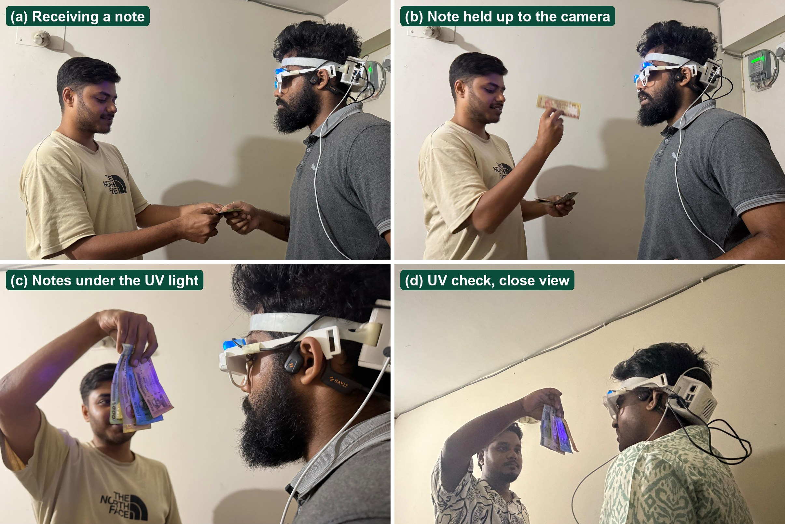
Testing the worn glass: where the project stands
DONE
Engineering checks
Each part tested on held-out data, on a laptop and the Pi 5
PRELIMINARY
First field test
Glass camera: currency unreliable, Bangla text not read
IN PROGRESS
Participant trials
Sessions with a visually impaired participant have started
NONE YET
Completed user study
No results about users are claimed
Prototype version 2 in a staged shop exchange by team members; illustration only, no error rate counted.
Notes:
The second prototype on team members. The first field test with the glass camera was not good enough: currency was unreliable and Bangla text was not read, probably because of the low-resolution fixed-focus camera. Sessions with a visually impaired participant have started, with a Bangla voice questionnaire, but no user study is complete yet, so we make no claims about users.

Slide 22


Future work: the roadmap
1
2
3
4
Camera
User study
More banknotes
Speed and cooling
Higher resolution or autofocus
8–12 participants, including their own voice commands
Unseen counterfeit prints; UV check on real fakes
Time the new code on the Pi; better cooling; battery
Done: engineering tests In progress: participant trials Future: the four steps above
Notes:
Our roadmap has four steps. First, a better glass camera with higher resolution or autofocus, and a test set taken through the glass. Second, the user study with eight to twelve participants: task time, accuracy, SUS and NASA-TLX, including voice commands spoken by people and Bangla command words. Third, more banknotes: about a hundred unseen counterfeit prints with a bank or the police, and the UV check on real counterfeits. Fourth, speed and cooling: timing the new code on the Pi, better cooling and battery life.

Slide 23
Conclusion
Built
An offline Raspberry Pi 5 glass that reads Bangla and English, names objects and Taka notes, and speaks Bangla
Investigated
Synthetic training data, prefix training, unseen prints, a safe verdict, DMWR, hand-held notes, OCR, voice
Still to validate
Real counterfeits (also under UV), people's voices, the glass camera, a completed user study
Notes:
To sum up: SARA turns three everyday moments, money, reading and the street, into questions the user can ask the glass. It is an assistive glass that speaks Bangla and runs on a Raspberry Pi 5, tested part by part on held-out data, with new methods for counterfeit checking and hand-held notes. Still to be validated: real counterfeit notes, including under the UV lamp; voice commands spoken by people; the glass camera; and a completed user study.

Slide 24
Thank you
Questions?
SARA · Smart Assistive Reading Aid
Notes:
Thank you; we are happy to take questions.

Slide 25
References
[1] World Health Organization. Blindness and vision impairment: fact sheet, 2023.
[2] OrCam Technologies. OrCam MyEye.
[3] Ali A., H. et al. A Google Glass based real-time scene analysis for the visually impaired. IEEE Access 9, 2021.
[4] Brilli, D. D. et al. AIris: an AI-powered wearable assistive device for the visually impaired. arXiv:2405.07606, 2024.
[5] Baek, Y. et al. Character region awareness for text detection (CRAFT). CVPR, 2019.
[6] JaidedAI. EasyOCR: ready-to-use OCR with 80+ languages.
[7] Jocher, G., Chaurasia, A., Qiu, J. Ultralytics YOLOv8.
[8] Lin, T.-Y. et al. Microsoft COCO: common objects in context. ECCV, 2014.
[9] Li, S., Deng, W., Du, J. Reliable crowdsourcing and deep locality-preserving learning for expression recognition in the wild (RAF-DB). CVPR, 2017.
[10] Rhasspy. Piper: a fast, local neural text-to-speech system.
[11] eSpeak NG text-to-speech.
[12] A diverse image dataset for Bangladeshi currency recognition (BanglaTaka). Mendeley Data.
[13] Rafi, M. J. A., Rony, M., Majadi, N. NSTU-BDTAKA: an open dataset for Bangladeshi paper currency detection and recognition. Data in Brief 55, 2024.
[14] Piyas, B. R. C. et al. JaalTaka: a benchmark dataset for detecting counterfeit Bangladeshi banknotes. Mendeley Data V2, 2025.
[15] Piyas, B. R. C. et al. JaalTaka: a benchmark dataset for detecting counterfeit Bangladeshi banknotes. Data in Brief 64, 112377, 2026.
[16] Uddin, M. S., Das, P. P., Roney, M. S. A. Image-based approach for the detection of counterfeit banknotes of Bangladesh. ICIEV, 2016.
[17] Pathak, A. et al. Enhanced counterfeit detection of Bangladesh currency through convolutional neural networks. IJIRCST 12(2), 2024.
[18] Sandler, M. et al. MobileNetV2: inverted residuals and linear bottlenecks. CVPR, 2018.
[19] Chowdhury, A. A. et al. Evaluation of deep learning models on UV ink: a fake money detection scheme with RPN. ICCA (ACM), 2022.
[20] Mutanen, J., Jaaskelainen, T., Parkkinen, J. P. S. Luminescent security properties of banknotes. IS&T PICS Conference, 2003, pp. 421-424.
[21] Nayef, N. et al. ICDAR2019 robust reading challenge on multi-lingual scene text (RRC-MLT-2019). ICDAR, 2019.
[22] Alpha Cephei. Vosk offline speech recognition toolkit.
[23] Piczak, K. J. ESC: dataset for environmental sound classification. ACM Multimedia, 2015.
Notes:
The sources cited on the slides, numbered as in the slides.

Slide 26



Links
Our code and results
Datasets
Open-source tools
SARA: glass software for the Raspberry Pi 5
github.com/aflam330/SARA
Research repository: experiments, results, thesis
github.com/aflam330/Senior_project_wearable_glass_for_blind_people_using_ocr_and_ylo
JaalTaka (counterfeit notes)
data.mendeley.com/datasets/2m7wk5cy4c/2
BanglaTaka (note photos)
data.mendeley.com/datasets/3cv2sypkkh/1
NSTU-BDTAKA (hand-held notes)
www.sciencedirect.com/science/article/pii/S2352340924006681
Microsoft COCO
cocodataset.org
ICDAR 2019 MLT
rrc.cvc.uab.es/?ch=15
ESC-50 environmental sounds
github.com/karolpiczak/ESC-50
Ultralytics YOLOv8
github.com/ultralytics/ultralytics
EasyOCR
github.com/JaidedAI/EasyOCR
Piper text-to-speech
github.com/rhasspy/piper
Vosk speech recognition
alphacephei.com/vosk/
eSpeak NG
github.com/espeak-ng/espeak-ng
WHO vision fact sheet
www.who.int/news-room/fact-sheets/detail/blindness-and-visual-impairment
Notes:
Our code is public on GitHub: the glass software and the research repository with every experiment. The datasets and open-source tools we used are linked here.

